Slide 1
WORLD OF LASERS
Laser Invention

Slide 2
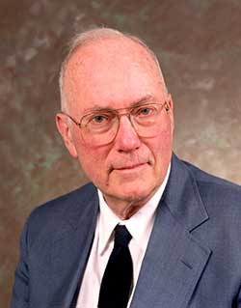
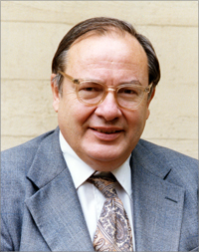
?
WHO ARE THE INVENTORS
Lasers is based on masers, which were invented in the 1950s by Charles Townes and Arthur Schawlow.

Slide 3
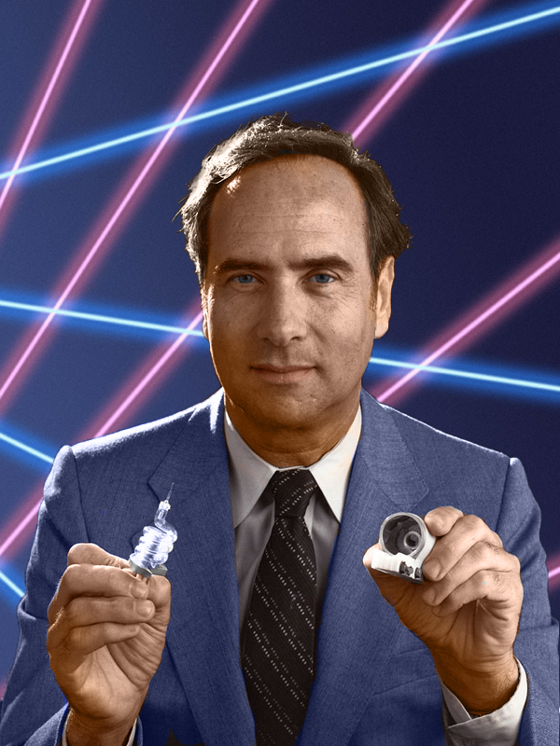
?
WHO ARE THE INVENTORS
Although Townes and Schawlow are often credited with inventing lasers, the first person to build a working, visible light laser was actually Theodore Maiman.

Slide 4
?
WELL DONE!
Now you can move on to the next topic...
LASER APPLICATIONS!

